Slide 1
Hadoop File System
HDFS

Slide 2
Features of HDFS
It is suitable for the distributed storage and processing.
Hadoop provides a command interface to interact with HDFS.
The built-in servers of namenode and datanode help users to easily check the status of cluster.
Streaming access to file system data.
HDFS provides file permissions and authentication.

Slide 3
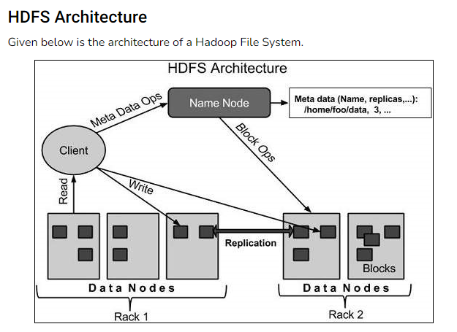

Slide 4
Namenode
The namenode is the commodity hardware that contains the GNU/Linux operating system and the namenode software.
It is a software that can be run on commodity hardware.
The system having the namenode acts as the master server and it does the following tasks −
Manages the file system namespace.
Regulates client’s access to files.
It also executes file system operations such as renaming, closing, and opening files and directories.

Slide 5
Datanode
The datanode is a commodity hardware having the GNU/Linux operating system and datanode software.
For every node (Commodity hardware/System) in a cluster, there will be a datanode.
These nodes manage the data storage of their system.
Datanodes perform read-write operations on the file systems, as per client request.
They also perform operations such as block creation, deletion, and replication according to the instructions of the namenode.

Slide 6
Block in HDFS
Generally the user data is stored in the files of HDFS.
The file in a file system will be divided into one or more segments and/or stored in individual data nodes. These file segments are called as blocks.
In other words, the minimum amount of data that HDFS can read or write is called a Block.
The default block size is 64MB, but it can be increased as per the need to change in HDFS configuration.

Slide 7
Goals of HDFS
Fault detection and recovery − Since HDFS includes a large number of commodity hardware, failure of components is frequent. Therefore HDFS should have mechanisms for quick and automatic fault detection and recovery.
Huge datasets − HDFS should have hundreds of nodes per cluster to manage the applications having huge datasets.
Hardware at data − A requested task can be done efficiently, when the computation takes place near the data. Especially where huge datasets are involved, it reduces the network traffic and increases the throughput.

Slide 8
Starting HDFS
Initially you have to format the configured HDFS file system
$ hadoop namenode -format
After formatting the HDFS, start the distributed file system
$ start-dfs.sh

Slide 9
Listing Files in HDFS
After loading the information in the server, we can find the list of files in a directory, status of a file, using ‘ls’.
hadoop fs -ls / // list out the files in hadoop or hdfs dfs -ls / // list out the files in Hadoop
hdfs dfs -ls /bigdata // list out the files in bigdata directory

Slide 10
Inserting Data into HDFS
Assume we have data in the file called sample.txt in the local system which is ought to be saved in the hdfs file system.
Step 1
You have to create an input directory.
hadoop fs -mkdir /bigdata
Step 2
Transfer and store a data file from local systems to the Hadoop file system using the put command.
hdfs dfs -put sample.txt /bigdata
// equivalent command of copyFromLocal
Step 3
You can verify the file using ls command.
hdfs dfs -ls /bigdata

Slide 11
Retrieving Data from HDFS
Assume we have a file in HDFS called outfile.
Step 1
Initially, view the data from HDFS using cat command.
hadoop fs -cat /bigdata/outfile
Step 2
Get the file from HDFS to the local file system using get command.
hdfs dfs -get /bigdata/sampledata.txt /home/cloudera
//// equivalent command of copyToLocal

Slide 12
create a file in Hadoop
hdfs dfs -touchz /bigdata/bigdatasample.txt

Slide 13
copy a file: linux to Hadoop
hdfs dfs -copyFromLocal /home/cloudera/sample.txt /bigdata
copy a file: Hadoop to linux
hdfs dfs -copyToLocal /bigdata/bigdatasample.txt /home/cloudera

Slide 14
jps
//java process:show you hdfs component
hdfs fsck /
//check the health of hdfs
hdfs dfs -du -s /bigdata/sampledata.txt
// check the file size
hdfs dfs -appendToFile - /bigdata/sampledata.txt
// add some contents to the existing file

Slide 15
Shutting Down the HDFS
You can shut down the HDFS by using the following command.
$ stop-dfs.sh

